Slide 1
Video
By Justin Ho
https://www.canva.com/design/DADXhF0NYBg/SPX3x5gtKVVHxwW6YO2tiA/edit?category=tACFasDnyEQ

Slide 2
About Me
Graduated in University of Illinois
B.S in Actuarial Science
Background in Entertainment, working on unscripted shows for Discovery, Animal Planet, Travel

Slide 3
Project Motivation
Transcription and Logging is a huge part of the industry.
Using data science to extract meaningful content from interview footage
Data Source

Slide 4
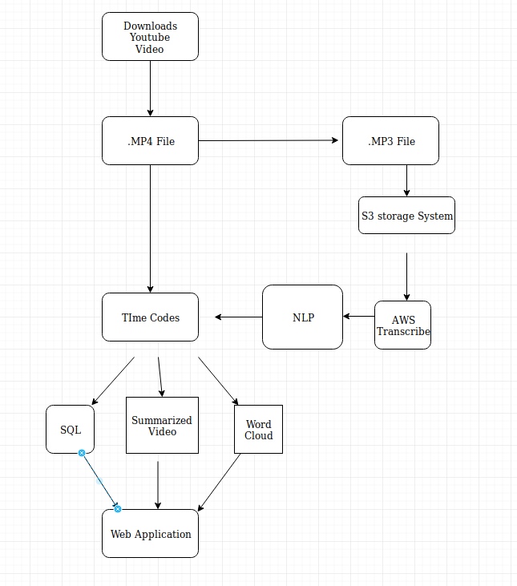

Slide 5
Demo

Slide 6
Potential

